Slide 1
Homework 2
Evaluate the pros and cons of cloud service providers you researched in Homework 1 and make a recommendation for a hypothetical business use case
Submission:
Submit your compiled list in a well-organized document
Submit to the Blackboard by November 19th

Slide 2
COMP3050 Cloud Computing Technology

Slide 3
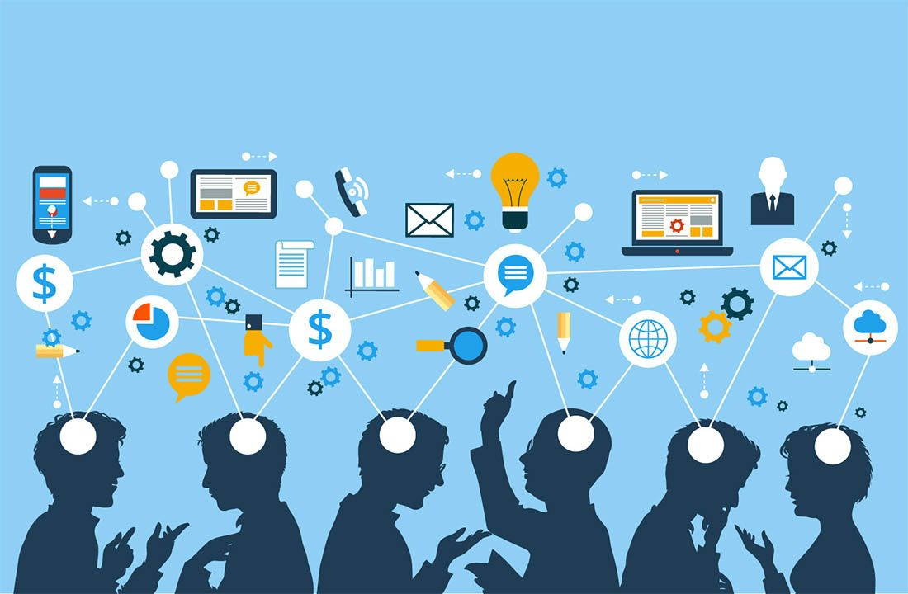
Cloud Service Models

Slide 4
Intended learning outcomes
After completing this topic, you will be able to:
Differentiate between different types of cloud service models
Be able to choose the appropriate cloud service model for different needs

Slide 5
Cloud service models
Introduction and evolution of cloud service models
Infrastructure as a Service (IAAS)
Platform as a Service (PAAS)
Software as a Service (SAAS)
More Services (XAAS)
Comparison between different models

Slide 6
Recall our cloud computing definition
Cloud computing is the delivery of different services through the Internet, which includes tools and applications like data storage, servers, databases, networking, and software.

Slide 7
different services available in the cloud
Access to physical servers, virtual servers, storage, networking - Infrastructure
Access to platforms for developing, running, maintaining and managing applications - Platform
Access to application software – Software

Slide 8
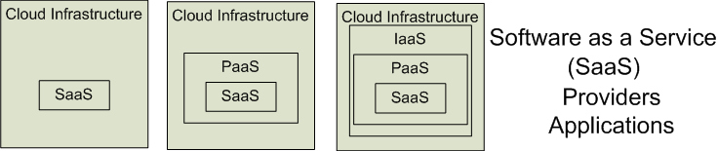

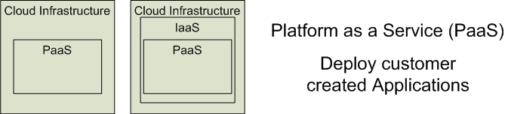

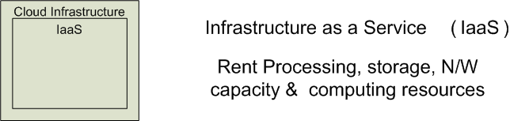


Cloud Service Models
Software as a Service (SaaS)
Platform as a Service (PaaS)
Infrastructure as a Service (IaaS)
SalesForce CRM
LotusLive
Google App Engine

Slide 9
Cloud service models
IaaS – Infrastructure
PaaS – Platform
SaaS – Software
as a Service

Slide 10
'… as a service’ (1)
refers to the way IT assets are consumed
It also describes the essential difference between cloud computing and traditional IT

Slide 11
'… as a service’ (2)
In traditional IT, an organization consumes IT assets - hardware, system software, development tools, applications - by purchasing them, installing them, managing them and maintaining them in its own on-premises data center.

Slide 12
'… as a service’ (3)
In cloud computing, the cloud service provider owns, manages and maintains the assets; the customer consumes them via an Internet connection, and pays for them on a subscription or pay-as-you-go basis.
There are three main types of as-a-Service solutions:
IaaS
PaaS
SaaS

Slide 13
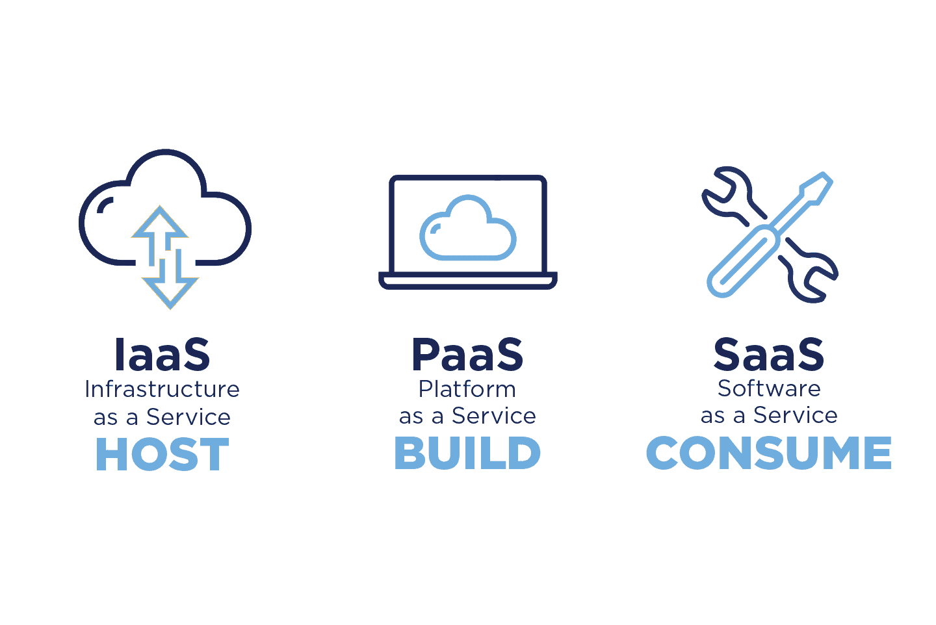

Slide 14
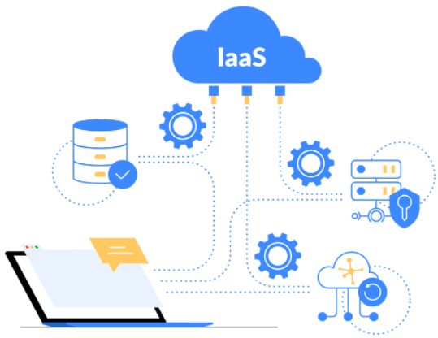
What is infrastructure
Servers
Storage capacity
Networking resources
Details were discussed last time

Slide 15
Platform as a Service (PAAS) - 1
Platform as a Service is software that provides access to development tools, APIs, and deployment instruments
Users receive access to virtual development environments and Cloud storage, where they can build, test, and run applications.

Slide 16
User activities in PaaS
Tests cloud based solutions and cloud services
Develops cloud based solutions and cloud services
Manages cloud based solutions and cloud services
Deploys cloud based solutions and cloud services

Slide 17
Typical level of control granted to cloud user in PaaS
Limited administrative

Slide 18
Cloud provider activities in PaaS
Pre-configure platform
Provision underlying infrastructure, middleware and other required IT resources
Monitor usage by a consumer of the cloud

Slide 19
Who manages what in PaaS model
PaaS means the hardware and an application-software platform are provided and managed by an outside cloud service provider
The user handles the apps running on top of the platform and the data the app relies on.

Slide 20
Vendors of PaaS
Google AppEngine
Microsoft Azure
Amazon AWS Elastic Beanstalk
Yahoo developer Network
…

Slide 21
PaaS examples - AWS Elastic Beanstalk
A web platform for software deployment and management, powered by the AWS Cloud
Users upload their applications to the service, and it automatically monitors the performance, load capacity, and checks for deployment errors

Slide 22
PaaS examples - Apache Stratos
The Cloud computing platform that helps run Apache Tomcat, PHP, and MySQL applications
It can be extended to support many more environments on all major cloud infrastructures.
It provides users with ready-to-use tools for database development and testing, performance monitoring, integration, and billing.

Slide 23
PaaS advantages
In PaaS, users have access to cloud-based platform (hardware and software) for developing, running, managing applications
Can you think of at least one advantage of PaaS as compared to developing applications in traditional way?

Slide 24

Open Question
Points: 10
In PaaS, users have access to cloud-based platform (hardware and software) for developing, running, managing applications.
Can you think of at least one advantage of PaaS as compared to developing applications in traditional way?
Open Question is only supported on Version 2.0 or newer.
Answer

Slide 25
PaaS advantages - less development time
The primary benefit of PaaS is that it allows customers to build, test, deploy run, update and scale applications more quickly and cost-effectively than they could if they had to build out and manage their own on-premises platform.
simplifies the entire process
enhances the focus of the development team
Faster time to market
PaaS enables development teams to spin-up development, testing and production environments in minutes, vs. weeks or months.

Slide 26
PaaS advantages - support for multiple programming languages
PaaS supports multiple programming languages which software development companies can use for building applications for various projects.

Slide 27
PaaS advantages - increased collaboration
Application development teams can collaborate with each other when they are dispersed across various physical locations
As a cloud-based service, PaaS provides a shared software development environment, giving development and operations teams access to all the tools they need, from anywhere with an Internet connection.

Slide 28
PaaS advantages -adoption of new technologies
PaaS platforms typically include access to a wide range of the latest resources up and down the application stack.
This allows companies to test new operating systems, languages, and other tools without having to make substantial investments in them, or in the infrastructure required to run them.

Slide 29
Challenges with PaaS
PaaS technologies pose particular problems and risks for service providers
balancing control, cost, and capacity of a PaaS-based service
providing full multi-tenancy support
designing role-based access controls
…

Slide 30
PaaS use cases (1)
API development and management
With its built-in frameworks, PaaS makes it easier for teams to develop, run, manage and secure APIs for sharing data and functionality between applications.
API - Application Programming Interface
mechanisms that enable two software components to communicate with each other using a set of definitions and protocols
Example
the weather bureau’s software system contains daily weather data
the weather app on your phone “talks” to this system via APIs and shows you daily weather updates on your phone

Slide 31
PaaS use cases (2)
Internet of Things (IoT)
PaaS supports a range of programming languages (Java, Python, Swift, etc.), tools and application environments used for IoT application development and real-time processing of data from IoT devices.
IoT
the network of physical objects—“things”—that are embedded with sensors, software, and other technologies for the purpose of connecting and exchanging data with other devices and systems over the internet
These devices range from ordinary household objects to sophisticated industrial tools.

Slide 32
PaaS use cases (3)
Agile development and DevOps
PaaS solutions typically cover all the requirements of a DevOps toolchain, and provide built-in automation to support continuous integration and continuous delivery (CI/CD).
DevOps
a set of practices that combines software development and IT operations
It aims to shorten the systems development life cycle and provide continuous delivery with high software quality. DevOps is complementary with Agile software development

Slide 33
PaaS use cases (4)
Cloud-native development and hybrid cloud strategy
PaaS solutions support cloud-native development technologies - microservices, containers, Kubernetes, serverless computing
A cloud-native application is a program that is designed for a cloud computing architecture

Slide 34
Discussion
Suppose a large organization wants to deliver a customer relationship management (CRM) application to its sales team.
CRM software connects all the data from sales leads and customers. It consolidates all communications (form fills, calls, emails, text messages, and meetings), documents, quotes, purchases, and tasks associated with each lead and client.
Can they choose a PaaS model?

Slide 35
Multiple Choice(single)
Points: 1
Suppose a large organization wants to deliver a customer relationship management (CRM) application to its sales team.
(*) CRM software connects all the data from sales leads and customers. It consolidates all communications (form fills, calls, emails, text messages, and meetings), documents, quotes, purchases, and tasks associated with each lead and client.
Can they choose a PaaS model?
A
YES
B
NO
Submit

Slide 36
Answer
Yes

Slide 37
Discussion
If the company chooses a PaaS model,
what will be their own responsibility?
what will be provided by the cloud provider?

Slide 38
Open Question
Points: 10
If the company chooses a PaaS model, what will be their own responsibility and what will be provided by the cloud provider?
Open Question is only supported on Version 2.0 or newer.
Answer

Slide 39
Answer
They can choose a PaaS solution and build a custom CRM application using the platform provided in the cloud.
The company would offload management of infrastructure and application development resources to the cloud service provider.
The customer would retain complete control over application features, but it would also assume responsibility for managing the application and associated data.

Slide 40
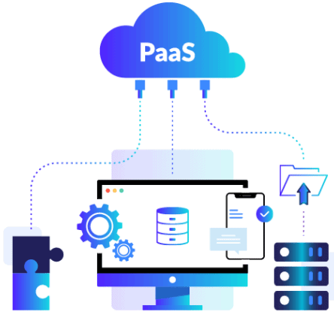

Slide 41
Cloud services
Cloud services are infrastructure, platforms, or software that are hosted by third-party providers and made available to users through the internet.

Slide 43
Software as a Service (SAAS)

Slide 44
Software as a Service (SAAS)
Software is hosted by third-party providers and made available to users through the internet
(SaaS) is a software licensing and delivery model
A web platform that provides users access to cloud computing on a subscription basis
Instead of purchasing the solution one time, as if it would be a product, the software is delivered continuously — like a service.

Slide 45
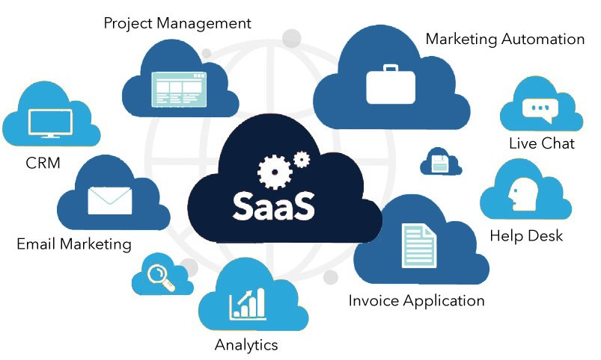
What is software
web applications or mobile apps that users can access via a web browser

Slide 46
How is software provided
SaaS is a service that delivers a software application—which the cloud service provider manages—to its users
Software updates, bug fixes, and other general software maintenance are taken care of for the user
SaaS apps are web applications or mobile apps that users can access via a web browser
Users connect to the cloud applications via a dashboard or API
SaaS eliminates the need to have an app installed locally on each individual user’s computer
allowing team access to the software

Slide 47
SaaS characteristics
Centralized Hosting /Delivery
Users are provided with applications that are accessible anytime and from anywhere
These applications are provided in one-to-many mechanism
UI powered by “thin client” applications
SLA – Service Level Agreement
Stateless
Loosely coupled
Modular

Slide 48
User activities in SaaS
Uses cloud service
Configures cloud service

Slide 49
Typical level of control granted to cloud user in SaaS
Usage
Usage-related configuration

Slide 50
Cloud provider activities in SaaS
Manage, maintain and implement cloud service
Monitor usage by the consumer of cloud

Slide 51
Who manages what in SaaS model
The application and all of the infrastructure required to deliver it - servers, storage, networking, middleware, application software, data storage - are hosted and managed by the SaaS vendor
The vendor also manages all upgrades and patches to the software, usually invisibly to customers
Customers can add more users and data storage on demand at additional cost

Slide 52
Vendors of SaaS
Saleforce.com,
Microsoft Office 365
Google documents,
Clarizen.com,
Gmail,
Hotmail,
Quicken online,
Netsuite,

Slide 53
Examples of SaaS - Microsoft Office 365
The series of web services that provide business owners and individuals with access to Microsoft Office main tools directly from their browsers
Users can access Microsoft editing tools, business email, communication instruments, and documentation software

Slide 54
Examples of SaaS - Salesforce
The most popular CRM on the market that unites marketing, communication, e-commerce
Business owners can keep track of their sales, client relations, communications, and relevant tasks from any device
Salesforce can be integrated into the website — the information about incoming leads will be sent to the platform automatically

Slide 55
SaaS advantages
SaaS apps are web applications or mobile apps that users can access via a web browser instead of installing them on their devices
Can you think of at least one advantage of SaaS?

Slide 56
Open Question
Points: 10
SaaS apps are web applications or mobile apps that users can access via a web browser instead of installing them on their devices.
Can you think of at least one advantage of SaaS?
Open Question is only supported on Version 2.0 or newer.
Answer

Slide 57
SaaS advantages – offloads most of the management to cloud provider
Offloads application management to the SaaS vendor
Offloads infrastructure management to the SaaS vendor
SaaS model removes the need of infrastructure
it uses the infrastructure of cloud itself

Slide 58
SaaS advantages – reduced cost
Pay only for what you use
Eliminates the expenditure involved with the purchase, installation, maintenance, and up-gradation of the computing hardware and software
Minimal financial risk
Many SaaS products offer a free trial period, or low monthly fees that let customers try the software to see if it will meet their needs, with little or no financial risk

Slide 59
SaaS advantages – reduced time
Ready to use
Users can run most SaaS apps directly from their web browser without needing to download and install any software

Slide 60
SaaS advantages - anytime/anywhere productivity
With this model, businesses can access the services remotely using any device including smartphones

Slide 61
SaaS advantages - automatic updates
Software upgrades and package installation (or re-installation) can pose headaches for business operators because these consume business hours that businesses could use to find (and serve) new customers
The SaaS model removes such problems because service providers typically deploy upgrades on centrally hosted software applications
This ensures SaaS customers enjoy smooth, uninterrupted transitions to higher levels of service

Slide 62
Challenges with SaaS
Vulnerable to unauthorized access and hacking
Service providers must continuously invest in improving security and authentication processes on the cloud

Slide 63
SaaS use cases (1)
Today, just about any personal or employee productivity application is available as SaaS
If an end user or organization can find a SaaS solution with the required functionality, in most cases it will provide a significantly simpler, more scalable and more cost-effective alternative to on-premises software.
Many applications designed originally for the desktop (e.g., Adobe Creative Suite) are now available as SaaS (e.g., Adobe Creative Cloud).

Slide 64
SaaS use cases (2)
SaaS applications people use every day in their personal lives
email
social media
cloud file storage solutions
…

Slide 65
SaaS use cases (3)
Business or enterprise SaaS solutions
customer relationship management software
marketing software
workflow management
collaboration and messaging
graphics
…

Slide 66
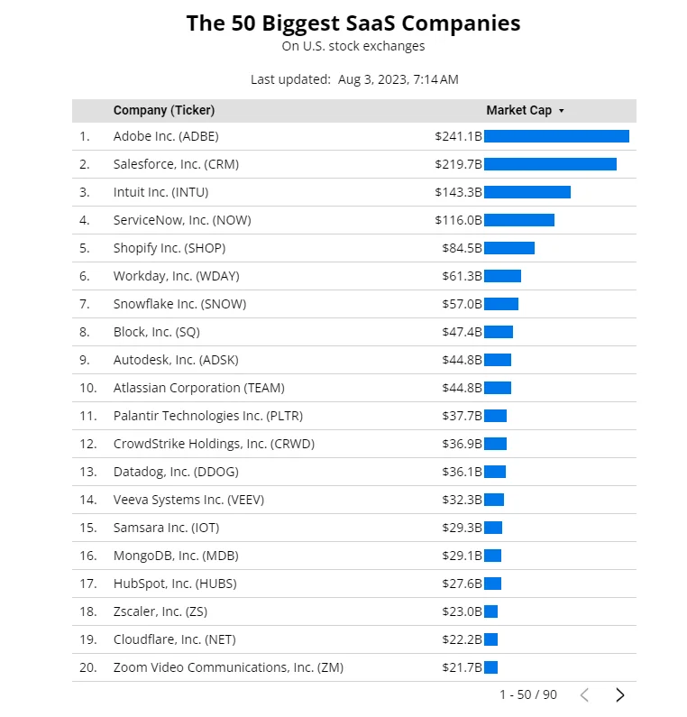

Slide 67
Discussion
Suppose a large organization wants to deliver a customer relationship management (CRM) application to its sales team.
CRM software connects all the data from sales leads and customers. It consolidates all communications (form fills, calls, emails, text messages, and meetings), documents, quotes, purchases, and tasks associated with each lead and client.
Can they choose a SaaS model?

Slide 68
Multiple Choice(single)
Points: 1
Suppose a large organization wants to deliver a customer relationship management (CRM) application to its sales team.
(*) CRM software connects all the data from sales leads and customers. It consolidates all communications (form fills, calls, emails, text messages, and meetings), documents, quotes, purchases, and tasks associated with each lead and client.
Can they choose a SaaS model?
A
YES
B
NO
Submit

Slide 69
Answer
Yes

Slide 70
Discussion
If the company chooses a SaaS model,
what will be their own responsibility?
what will be provided by the cloud provider?

Slide 71
Open Question
Points: 10
If the company chooses a SaaS model, what will be their own responsibility and what will be provided by the cloud provider?
Open Question is only supported on Version 2.0 or newer.
Answer

Slide 72
Answer
They can choose a SaaS CRM solution, offloading all day-to-day management to the third-party vendor, but also giving up all control over features and functionality, data storage, user access and security.

Slide 73
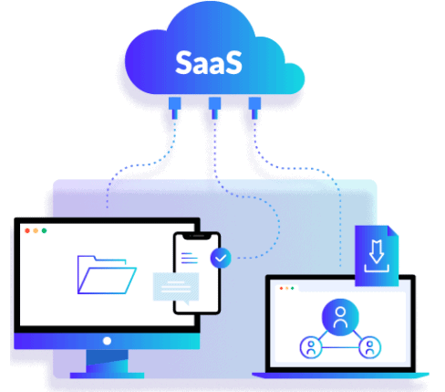

Slide 74
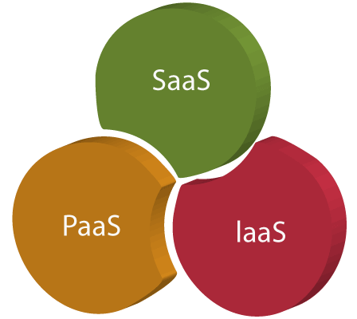
… as a service

Slide 75
… as a service
Traditional computing
Cloud computing
Computing resources are products
Own and managed internally by organizations and individuals
Computing resources become services

Slide 76
… as a service
Refers to the way IT assets are consumed in cloud computing
the cloud service provider owns, manages and maintains the assets
the customer consumes them via an Internet connection, and pays for them on a subscription or pay-as-you-go basis
There are three main types of as-a-Service solutions
IaaS
PaaS
SaaS
But there are other as-a-Service solutions available as well
XaaS

Slide 77
XaaS
There are other cloud service models described as XaaS
X represents Anything/Everything
Anything as a Service
Everything as a Service
X will be replaced with a letter describing the resource available as a service

Slide 78
Other cloud service models
Network as a service (NaaS)
Backup as a service (BaaS)
Database as a service (DBaaS)
Communications as a service (CaaS)
Storage as a service (STaaS)
Desktop as as service (DaaS)
Business Process as a Service (BPaaS)
Function as a Service (FaaS)
…

Slide 79
Comparison between the cloud service models
Which model should the business choose?

Slide 80
SaaS vs PaaS vs IaaS (1)
SaaS, Paas, IaaS are not mutually exclusive; most organizations use more than one, and many larger organizations today use all three, often in combination with traditional IT

Slide 81
SaaS vs PaaS vs IaaS (2)
The as-a-service solution a customer chooses depends first on the functionality the customer requires, and the expertise it has on staff
For example, an organization without the in-house IT expertise for configuring and operating remote servers isn't well matched to IaaS
An organization without a development team has no need for PaaS

Slide 82
SaaS vs PaaS vs IaaS (3)
In some cases, any of the three 'as-a-service' models will offer a viable solution
In these cases, organizations typically compare the alternatives based on the management ease they offer, vs. the control they give up

Slide 83
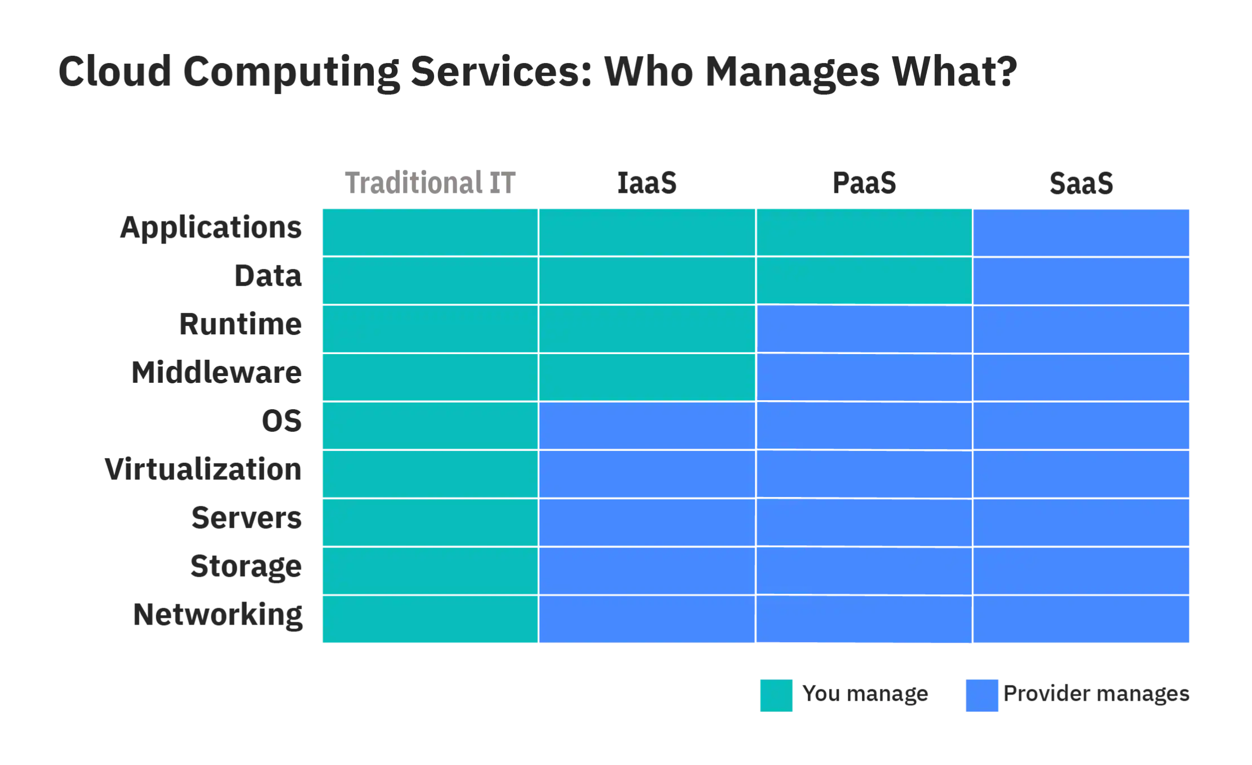
Management ease vs complete control

Slide 84
Review

Slide 85
Multiple Choice(single)
Points: 1
Which one of the following provides the resources or services such as virtual infrastructure, virtual machines, virtual storage, and several other hardware assets?
No answer，press the setting on the right side
A
IaaS
B
PaaS
C
SaaS
Submit

Slide 86
Multiple Choice(single)
Points: 1
Which one of the following provides the resources or services such as virtual infrastructure, virtual machines, virtual storage, and several other hardware assets?
A
IaaS
B
PaaS
C
SaaS
Submit

Slide 87
Discussion
In the IaaS (Infrastructure as a service) service provider maintains all the infrastructure, while the client is responsible for several other deployment aspects.

Slide 88
Azure is a public cloud computing platform—with solutions including Infrastructure as a Service (IaaS), Platform as a Service (PaaS), and Software as a Service (SaaS) that can be used for services such as analytics, virtual computing, storage, networking, and much more.
It has more than 200 products and cloud services
For the project you are currently working on, you plan to provide Infrastructure as a Service (IaaS) resources in Azure. Which resource is an example of IaaS?

Slide 89
Multiple Choice(single)
Points: 1
Remark
No answer，press the setting on the right side
Azure is a public cloud computing platform—with solutions including Infrastructure as a Service (IaaS), Platform as a Service (PaaS), and Software as a Service (SaaS) that can be used for services such as analytics, virtual computing, storage, networking, and much more.
It has more than 200 products and cloud services
For the project you are currently working on, you plan to provide Infrastructure as a Service (IaaS) resources in Azure. Which resource is an example of IaaS?
We can control hardware using IaaS resources
A
an Azure web app
B
an Azure virtual machine
C
an Azure logic app
D
an Azure SQL database
Submit
Text\Image\Formula are allowed and all the content should be placed in this area

Slide 90
Multiple Choice(single)
Points: 1
Remark
Azure is a public cloud computing platform—with solutions including Infrastructure as a Service (IaaS), Platform as a Service (PaaS), and Software as a Service (SaaS) that can be used for services such as analytics, virtual computing, storage, networking, and much more.
It has more than 200 products and cloud services
For the project you are currently working on, you plan to provide Infrastructure as a Service (IaaS) resources in Azure. Which resource is an example of IaaS?
We can control hardware using IaaS resources
A
an Azure web app
B
an Azure virtual machine
C
an Azure logic app
D
an Azure SQL database
Submit
Text\Image\Formula are allowed and all the content should be placed in this area

Slide 91
Multiple Choice(single)
Points: 1
Which one of the following can be considered as the most complete cloud computing service model?
No answer，press the setting on the right side
A
IaaS – Infrastructure as a Service
B
PaaS - Platform as a Service
C
SaaS – Software as a Service
Submit

Slide 92
Multiple Choice(single)
Points: 1
Which one of the following can be considered as the most complete cloud computing service model?
A
IaaS – Infrastructure as a Service
B
PaaS - Platform as a Service
C
SaaS – Software as a Service
Submit

Slide 93
Discussion
The most complete cloud computing service model must contain the computing hardware and software, as well as the solution itself.
Hence the SaaS model has all these features.

Slide 94
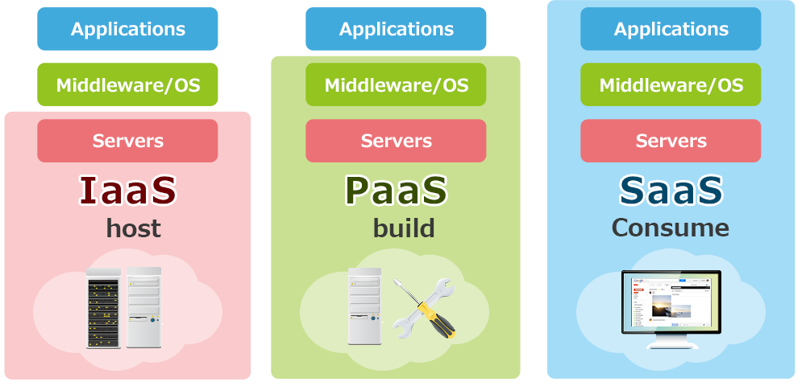
Discussion

Slide 95
Example - discussion
Labi Xiaoxin Food Industry Co., Ltd was established in 2000. The company is based in the Wuli Science & Technology Park in Jinjiang City. Its key products are sold in over 30 provincial areas nationwide. The company has become one of the top biggest jelly and candy manufacturer in China and has established close links with large retailers both at home and abroad, such as Walmart, Metro and Carrefour. The company’s products are exported to North America Europe and South-East Asia.
Currently, the company’s sales team uses outdated CRM software deployed on employee’s workstations. The sales team reported many problems using this CRM software.
Labi Xiaoxin Food Industry Co. wants to use cloud computing technology to deliver a customer relationship management (CRM) application to its sales team.

Slide 96
Example - discussion
In your opinion, which cloud service model can be used by Labi Xiaoxin Food Industry Co.?
IaaS
PaaS
SaaS
All of them
None of them

Slide 97
Example - discussion
In your opinion, which cloud service model can be used by Labi Xiaoxin Food Industry Co.?
IaaS
PaaS
SaaS
All of them
None of them

Slide 98
Comparison of the cloud service models

Slide 99
Example
In your opinion, which cloud service model will be best for Labi Xiaoxin Food Industry Co.? What additional information do you need to know to give your recommendation?
IaaS
PaaS
SaaS

Slide 100
Open Question
Points: 10
In your opinion, which cloud service model will be best for Labi Xiaoxin Food Industry Co.? What additional information do you need to know to give your recommendation?
Open Question is only supported on Version 2.0 or newer.
Answer

Slide 101
Discussion
To make the best decision, we still need to know:
What functionality is required
What problems employees are facing using the current CRM software
What benefits are expected from cloud-based solution
How much control the company wants to retain over different aspects of software development and deployment and how much of these tasks they prefer to offload to the 3rd party
application functionality
data storage
user access
security
management of infrastructure
Management of application development resources
Control over operating systems
Control over server configurations
…

Slide 102
Discussion
To make the best decision, we still need to know:
What functionality is required
What problems employees are facing using the current CRM software
What benefits are expected from cloud-based solution
How much control the company wants to retain over different aspects of software development and deployment and how much of these tasks they prefer to offload to the 3rd party
application functionality
data storage
user access
security
management of infrastructure
Management of application development resources
Control over operating systems
Control over server configurations
…

Slide 103
Discussion
Obviously, the as-a-service solution a customer chooses depends first on the functionality the customer requires, and the expertise it has on staff. For example
an organization without the in-house IT expertise for configuring and operating remote servers isn't well matched to IaaS
an organization without a development team has no need for PaaS

Slide 104
Discussion
To make the best decision, we still need to know:
What functionality is required
What problems employees are facing using the current CRM software
What benefits are expected from cloud-based solution
How much control the company wants to retain over different aspects of software development and deployment and how much of these tasks they prefer to offload to the 3rd party
application functionality
data storage
user access
security
management of infrastructure
Management of application development resources
Control over operating systems
Control over server configurations
…

Slide 105
Discussion
In some cases, any of the three 'as-a-service' models will offer a viable solution.
In these cases, organizations typically compare the alternatives based on the management ease they offer, vs. the control they give up.

Slide 106
Discussion
Let us consider how much control the company wants to retain over different aspects of software development and deployment and how much of these tasks they prefer to offload to the 3rd party

Slide 107
Discussion
If Labi Xiaoxin Food Industry Co. chose a SaaS CRM solution:
Use application provided by the provider
all day-to-day management would be offloaded to the third-party vendor
giving up all control over features and functionality, data storage, user access and security

Slide 108
Discussion
If Labi Xiaoxin Food Industry Co. chose a PaaS CRM solution:
Build a custom CRM application
Offload management of infrastructure and application development resources to the cloud service provider
Labi Xiaoxin would retain complete control over application features
However, Labi Xiaoxin would also assume responsibility for managing the application and associated data

Slide 109
Discussion
If Labi Xiaoxin Food Industry Co. chose a IaaS CRM solution:
Build out backend IT infrastructure on the cloud using IaaS
Use it to build its own development platform and application
Labi Xiaomi's IT team would have complete control over operating systems and server configurations
However, Labi Xiaomi would also bear the burden of managing and maintaining them, along with the development platform and applications that run on them.

Slide 110
Discussion
To propose the most beneficial solution, we would need to continue our analysis by learning more about Labi Xiaoxin and then choose solutions best suited to their situation
At the moment, we do not have enough information to make a specific suggestion

Slide 111
Summary
The IaaS model offers the computing resources companies need to host, build and run their services
The PaaS model provides an environment for developers to build and deploy applications
The SaaS model delivers software to users and companies over the Internet
Each cloud service model offers different features and benefits to businesses. Therefore, as we mentioned at the beginning of the article, these three cloud service models are often used simultaneously within companies

